Slide 1

Customer Retention for an Online Business

Slide 2
Contents
Problem statement & objective
Exploratory Data Analysis
Visualizations
Conclusion

Slide 3
1. Problem Statement & Objective
What is Customer Retention?
The customer retention definition in marketing is the process of engaging existing customers to continue buying products or services from your business. It indicates whether your product and the quality of the service please your existing customers. Customer Retention strategies are the processes and initiatives businesses put in place to build customer loyalty and improve customer lifetime value.
Why is it important?
You might have heard that it’s easier and less expensive to retain customers than to acquire them. The most recent statistics indicate that it’s true.
For one thing, you’ll spend five times less money on customer retention.
Additionally, at best, your probability of selling to an existing customer is at least 40 percent more likely than converting someone who has never bought from you before
What are its benefits?
-Retention is Cheaper than Acquisition.
-Loyal Customers are more profitable.
-Your Brand will stand out from the crowd.
-Engage customers provide more feedback.
-Loyal customers are more forgiving.
-Customers will explore your brand.

Slide 4

Objective
Successful customer retention involves more than giving the customer what they expect. Generating loyal advocates of the brand might mean exceeding customer expectations. Creating customer loyalty puts 'customer value rather than maximizing profits and shareholder value at the center of business strategy '. The key differentiation in a competitive environment is often the delivery of a consistently high standard of customer service. Furthermore, in the emerging world of Customer Success, retention is a major objective

Slide 5
Exploratory Data Analysis
There are 269 rows and 71 columns.
There are no missing values in the dataset.
There are unwanted characters in columns.
There are 70 object type variable and one is int64 variable, however it is also categorical in nature.

Slide 6
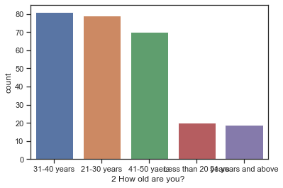
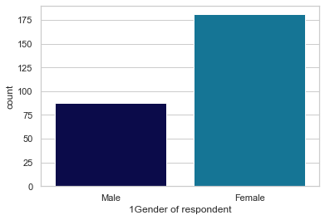
Exploratory Data Analysis
The age group of 31- 40 years and 21- 30 years are most in number, followed by age group 41-50.
Majority, 188 of the customers are Female whereas are 88 are male.

Slide 7
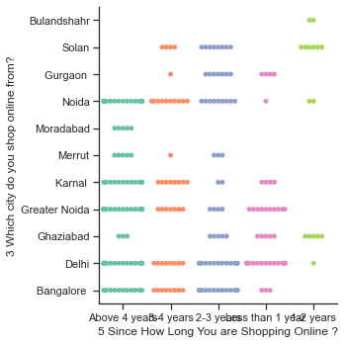
Exploratory Data Analysis
Delhi is the most prone for online shopping followed by Greater Noida and Noida
Moradabad and Bulandshahr has least number of shoppers.
Majority of people are shopping from more than 4 years.

Slide 8
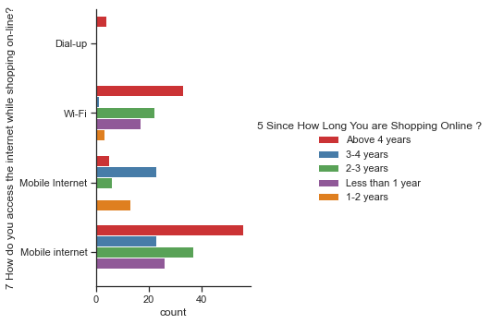
Exploratory Data Analysis
Majority of the respondents has shopped less than 10 times.
Very few are frequent buyers.
Approximately all the respondents prefer Mobile internet followed by WIFI
Dial-up network is least preferable.

Slide 9
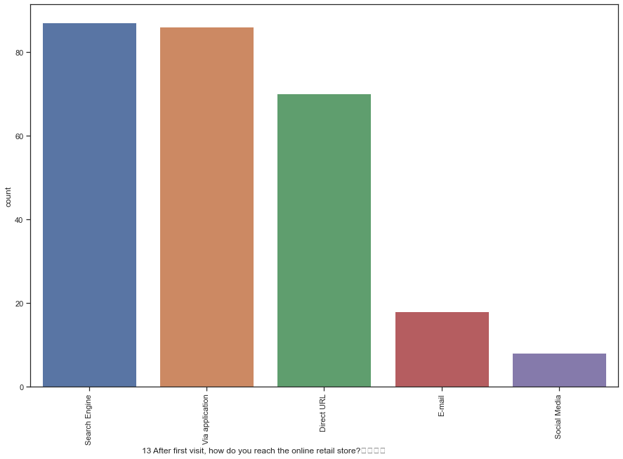
Exploratory Data Analysis
Most of the time search engine is preferred followed by application
Least preferred mode is social media as it is least trusted source.

Slide 10
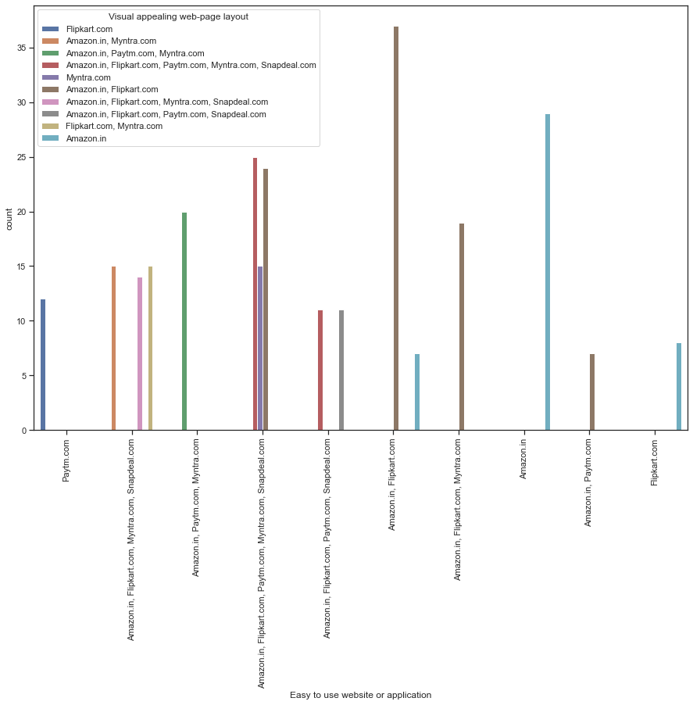
Exploratory Data Analysis
Easy to use websites or application are preferred (Like amazon.in)
Ease to navigate to website is Key(like loading and processing).This may include user friendliness, convenient pay option etc.

Slide 11
Visualizations
This paper investigated the factors that influence the online customers repeat purchase intention. During the process various data processing methods has been used to clean the data. The project contains extensive EDA considering every aspect.
The major finding is Complete relevant description of products and reliability of the website increases chances of customer retention. However, if the content on the website in not easy to read and understand or can't guarantee the privacy of the customer will lead to chances of customer retention.
This project has increased my understanding of the concept During the research I came across various challenges and while solving them I learned a lot of new things How to plot different chart. How to group data and visualize that. The limitation of the solution provided is that the data carried a lot of unrealistic values.

Slide 12
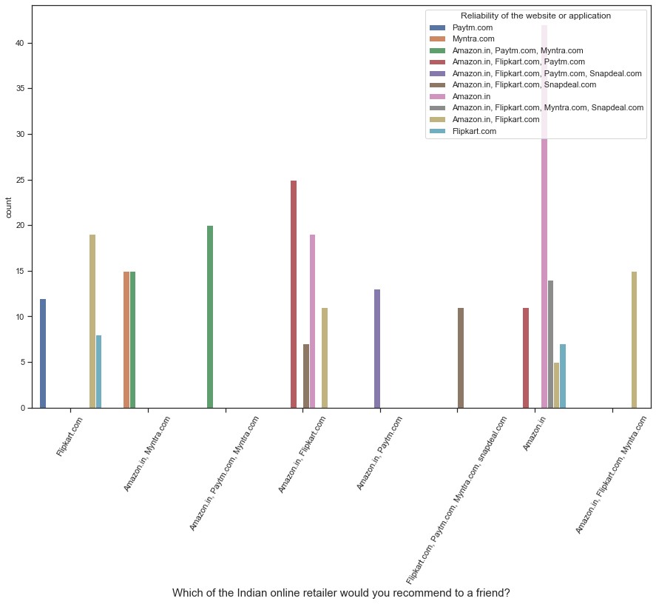
Conclusion
As in the final conclusion in which user were asked which online retailer they would recommend to a friend. Most of the respondents says Amazon. in because it is providing all the features that users want. Website is efficient and it is fast loading. It give complete, relevant description and information of products. It is reliable and quick to complete the purchase. Amazon give speedy delivery to its customers and there is several payment option available on the website. It provide online assistance through multi channels. Providing good deals on products. Amazon have a user friendly interface and has visual appealing webpage layout Amazon also offers wide variety of products and its application is easy to use. Lastly the main thing why user recommend it is because of its Trustworthiness and also its robust Security in protecting customer financial information and their Privacy information.

Slide 13
Thank you
Submitted By
Ankit soran

